Slide 1

Expedia Hotel Bookings
Group 4
AN NING
LIN YU-HUI (Marina)
LIU XINRAN
POOJA WADHWA
SHI YAWEN
TSAO YU-LUN (Luke)

Slide 2

Agenda
Project Overview
Hotel Booking Predictions
Our Dataset
Customer Segmentation
Exploratory Data Analysis
Market Basket Analysis
Customer Analytics Techniques Used
Recommender System
Conclusion

Slide 3


Project Overview
Expedia, as an online booking platform, with over 600 million monthly users on its site and accommodations in more than 200 countries.
As a customer centric organisation, they are motivated to deliver customized service offerings to their customers
Our analysis is designed to leverage customer data to enable Expedia with customized service offerings to its customers through various stages of customer lifecycle
Notes:
BP1:
In the current data-rich environment, more and more businesses attempt to understand their customers better through the use of customer analytics to bring their service to a higher level. Expedia, as an online booking platform, with over 600 million monthly users on its site and accommodations in more than 200 countries, is likely to be interested in retaining customers and hotel merchants.

Slide 4
Our Dataset
Our data includes logs of customer behavior when they are browsing in Expedia from 2013 Jan-2015 Jan* with about 22million rows of data with 25 different data attributes:
Description | Data Attributes
What customers searched for | Hotel searched: Hotel_cluster Travel destination (city/country/continent) searched
How they interacted with search results | Click/book
Hotel stay information | Check-in/out dates Number of adults and children
Attributes of the customer | Customer location (city/country/continent) Marketing channel
Search session attributes | How customer connected to Expedia: Whether they used mobile to connect Whether or not the search result was a travel package.
*The dataset used is based on random selection from Expedia and is not representative of the overall statistics.
Data source: Kaggle.com (Data supplied by Expedia)
Notes:
Hotel _cluster: Expedia has in-house algorithms to form hotel clusters, where similar hotels for a search (based on historical price, customer star ratings, geographical locations relative to city center, etc) are grouped together. These hotel clusters serve as good identifiers to which types of hotels people are going to book, while avoiding outliers such as new hotels that don't have historical data.
Red box Animation:
One caveat of our dataset is that: given the data is provided by Expedia, for confidentiality purposes, for the attibutes that are circled in RED, they are presented in integer code forms so that we are not able to explicitly know which exact location it is, we are only able to use the encoded integers to differentiate the location

Slide 5
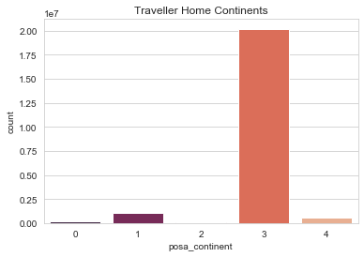
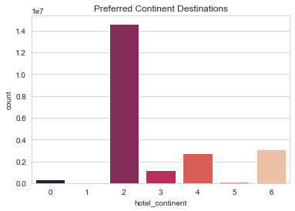
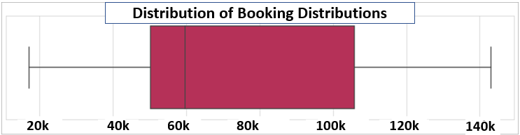
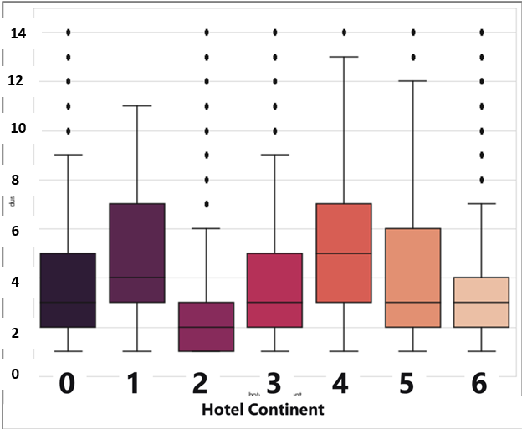
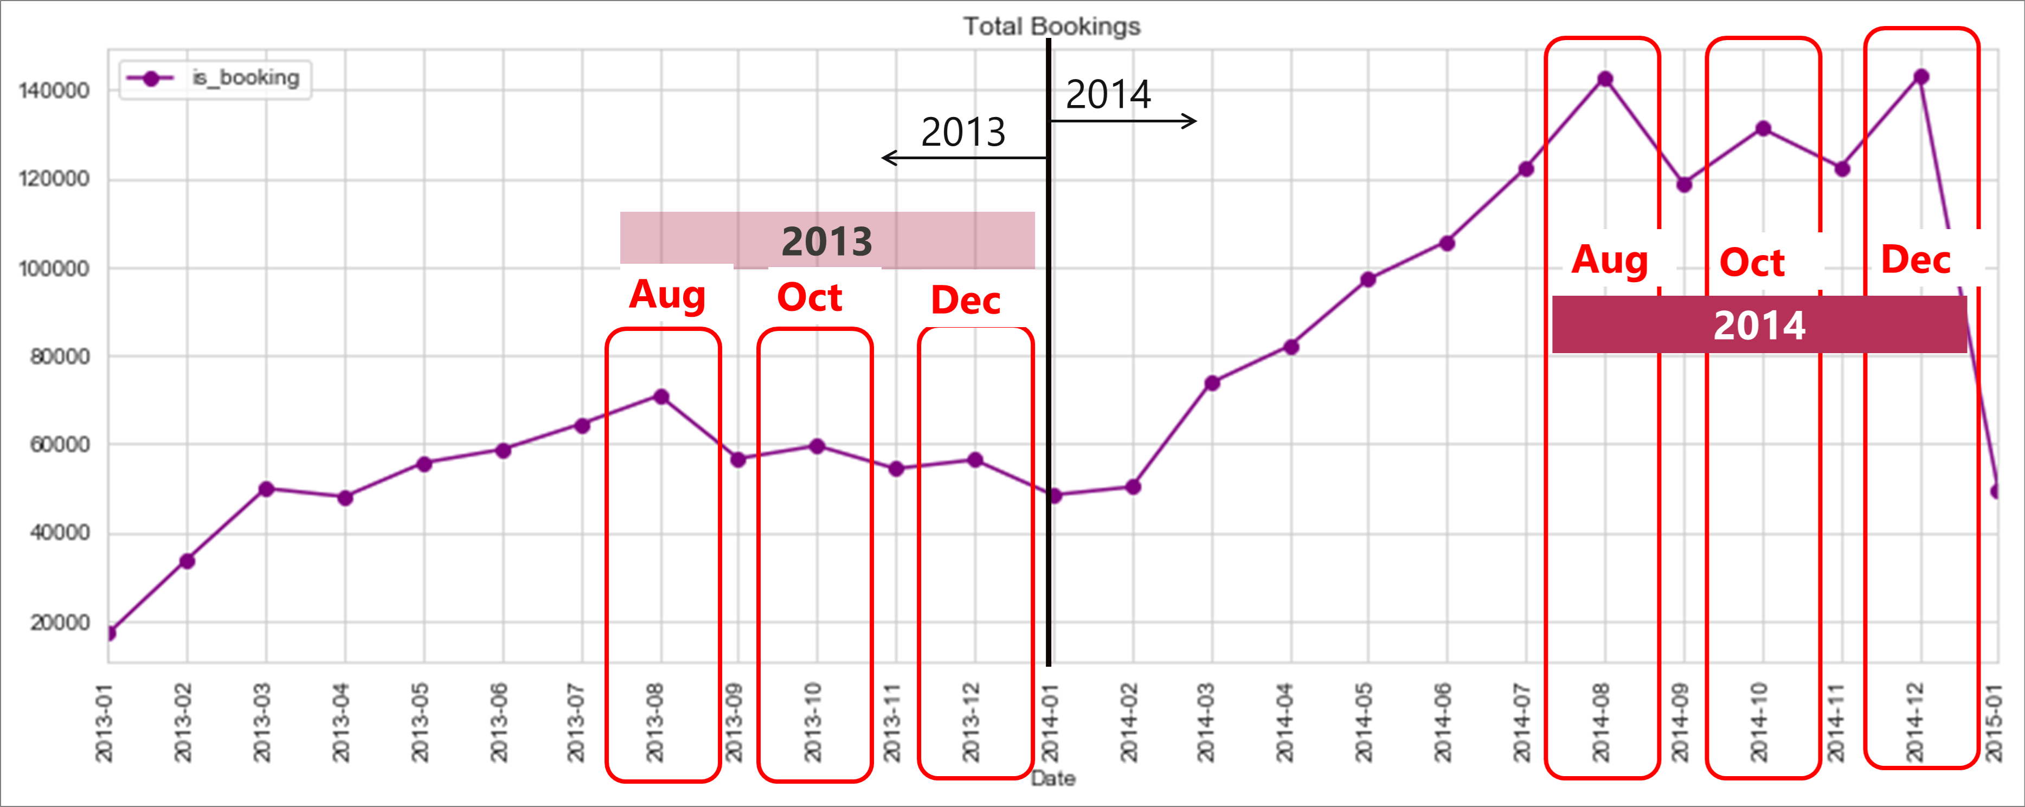
Exploratory Data Analysis
Most of the customers are from Continent 3 and searching for travel destinations in Continent 2 .
Monthly bookings range from 20k to 140k
Expedia’s peak period is in second half of the year, especially in the months of August, October and December
Travellers tend to stay in Continent 4 for longer durations per visit, compared to other continents

Slide 6
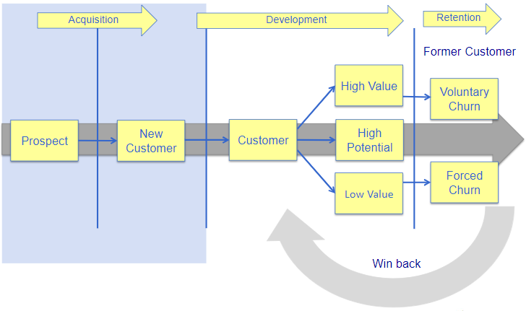
Analytical Techniques Used
Hotel Bookings Prediction
Market Segmentation
Market Basket Analysis
Hotel Recommendation System
Acquisition
Development
Retention
Adapted from Mastering Data Mining - The Art and Science of Customer Relationship Management by Michael J.A. Beery & Gordon S. Linoff
Customer Lifecycle

Slide 7
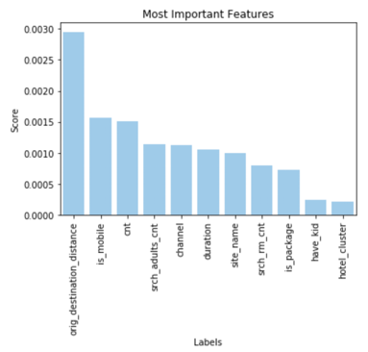
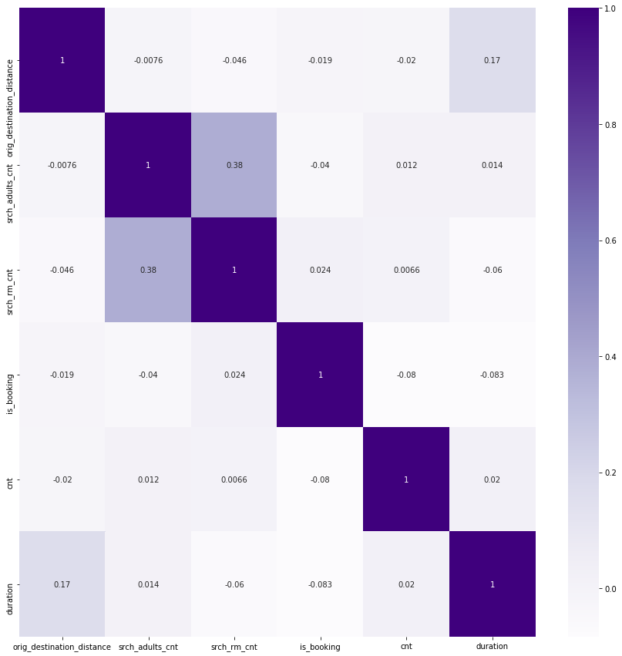
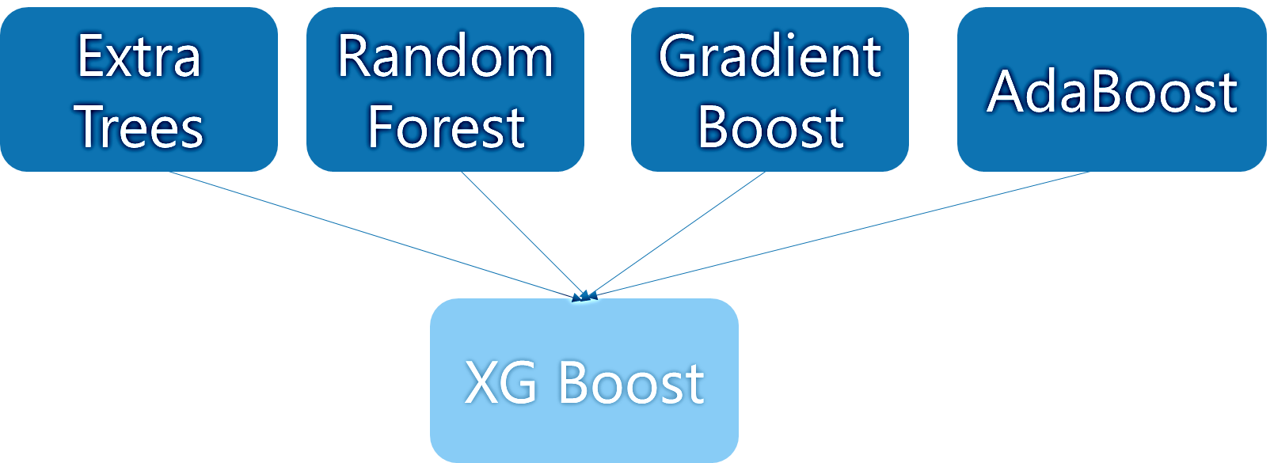
Customer Acquisition
Hotel Bookings Prediction
Purpose of the model:
Predicting whether customers book hotels or not
Data Subset
Top 1,000 active customers
280,958 rows of record
12 columns of input Features
Train : Test data split -- 70% : 30%
Kfold -- K = 6
Feature Engineering
Scaling and Transforming
Factorize
Check for multicollinearity
Most significance feature to model:
Distance between user location and hotel
Key Finding
No pair of variables are highly related to each other (i.e. all correlation coefficient are below 0.7)
Other important features:
User booking by mobile or not
Number of similar events in the context of the same user session
Ensemble Stacking Model
Accuracy: 94%
Notes:
The flow of presenting on this slides will be from left to right:
1. Explain the sub dataset, feature engineering, train_test_split, kfold, and ensemble stacking model
*heatmap (purple one) is for checking correlation between each pair of continuous variables. In our case, there is no pair of variables are dependent (correlated) to one another, so it meets the assumption of algorithms.
2. Feature importance based on our model (XG Boost): The most important one is distance. Besides, is_booking and cnt are also important.

Slide 8
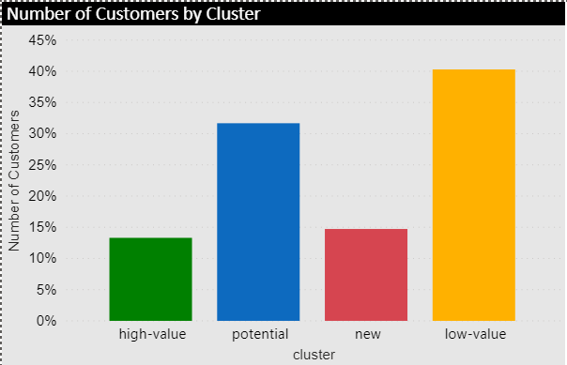

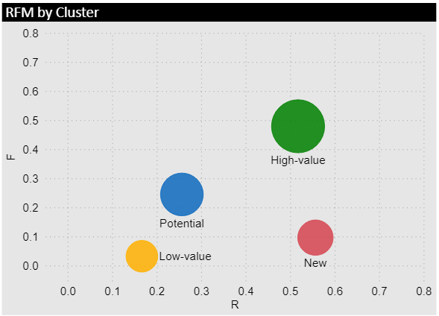
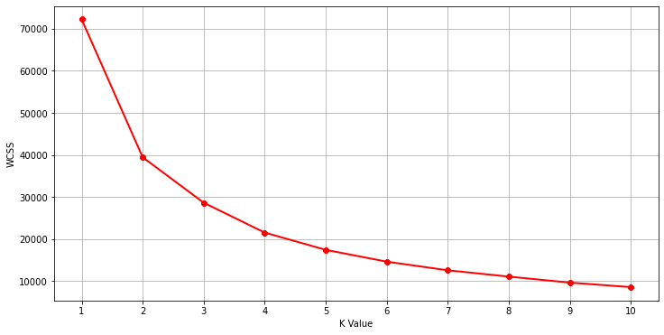

Customer Acquisition
Market Segmentation
using RFM Analysis
Frequency
Sum of Bookings per User
High-value customer
Recency
Latest booking time per user
Log
+
Normalize
K-Means
k-value = 4
Total Rooms
Sum of srch_rm_cnt /user
Selected based on the elbow point of WCSS vs K-value plot
Potential customer
To replace the M(monetary) aspect of RFM analysis
M: the size of bubble
New customer
Low-value customer
Notes:
Due to the lack of monetary, the number of rooms specified in the booking is used to indicate monetary.
assuming that the more rooms there are, the more expensive the booking price

Slide 9
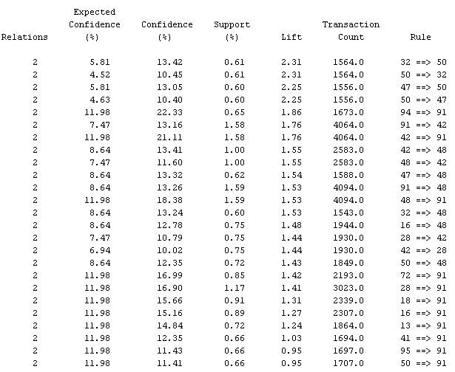
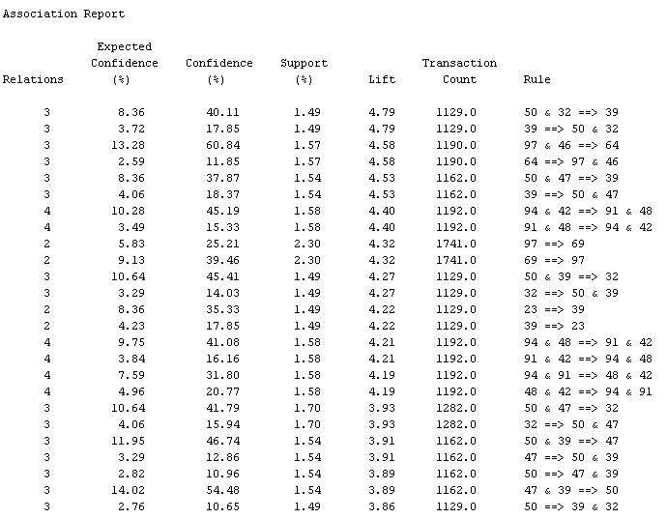
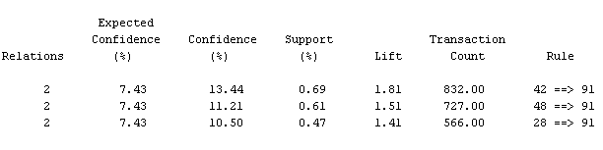
Customer Development
Market Basket Analysis
Report setting:
Min confidence level: 10
Support: 5%
Sorted by lift
ID: User_ID
Target: Hotel Cluster
Summary
Customer ID. : 108291 │ Records:1.4million │ Avg records/customer:13
Customer ID. : 257809 │ Records:925k│ Avg records /customer:4
High-value customer
Results of MBA analysis for High-value customer are relatively better than for other clusters, because it has a higher frequency and more booking records for each customer
MBA analysis is not recommended to use in this case, because it is hard for an individual to visit the many place within 1 or 2 years
Top 25 rules
2,3,and 4 relations
Central Point :48,50,46
Potential customer
Top 25 rules
Only 2 relations
Central Point: 48,91
Comparison Table
Cluster | AVG Confidence | AVG Support | AVG Lift
High Value | 28.15 | 1.73 | 3.33
Potential | 13.78 | 0.87 | 1.53
New | 11.71 | 0.59 | 1.57
Customer ID. : 119872 │ Records:259k│ Avg records/customer:2
* There are no such rules exist in low value customer
New customer
3 rules
Only 2 relations
Central Point: 91

Slide 10
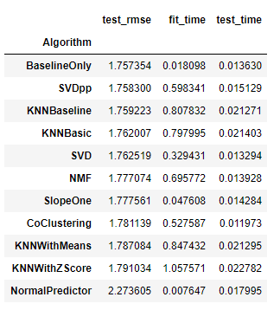
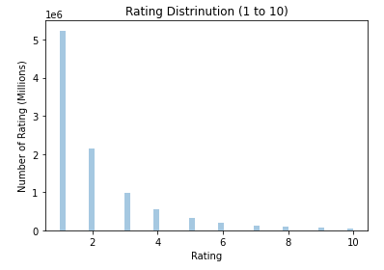
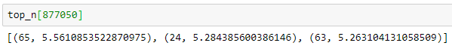
Customer Retention
Recommendation System
Feature
Engineering
Select Active Customers
Model Selection
Recommendation Result
In the absence of customer rating in our original dataset,
→ Created an implicit rating, which is the number of bookings for each user.
Select customers who have made at least 3 hotel bookings
Select the best forecasting model based on RMSE:
KNN Baseline
For each customer, we are able to recommend the user top 3 hotels
Example demo

Slide 11
Conclusion
Finding From Analysis | Management Strategies
Predict bookings with 94% accuracy; Distances between users and hotels influence bookings the most | Forecast hotel booking situation when entering new markets; Marketing campaigns focus more on long-distance travel/ short-distance travel
4 customer segments; Total rooms (Monetary) shows higher weighting in segmenting customer groups | More target marketing campaigns designed specifically to meet the preferences of each customer segment
Market Basket Analysis is not recommended in this case
Recommendation system | Expedia Hotel could provide personalized products to customers based on the recommendation system like the function we usually see in Amazon and Netflix.
Limitation | Future Work
Some of the data attributes are in encoded form | Link with external data to decode the locations to generate more practically-sensible insights
Sparse matrix making it difficult to derive sound recommendation | Collect and analyse data for longer period
‘Memory error’ encountered due to large data size | Include more data point with better CPU to run the models

